Slide 1
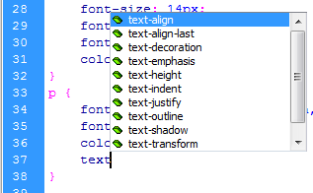
Web Authoring
Task 2 – Create Style Sheet
Write your own CSS for common styles like: h1, h2, h3, P, li – Save style sheet as “Text styles” Attach the style sheet and apply the text styles.
Heading 1 – H1 { font- family: San serif; font-size: 16; font-style: italic; colour: #F00; font-weight: bold; text-align: left; } | Heading 2 – H2 { font- family: Serif; font-size: 14; font-style: italic; colour: #00F; font-weight: bold; text-align: left; } | Heading 3 – H3 { font- family: San serif; font-size: 12; colour: #000; font-weight: bold; text-align: left; } | Paragraph – P { font- family: San serif; font-size: 12; colour: #000; text-align: left; } | List – LI { font- family: Serif; font-size: 14; colour: #F00; text-align: left; }
Example:
Heading 1 tags

Slide 2
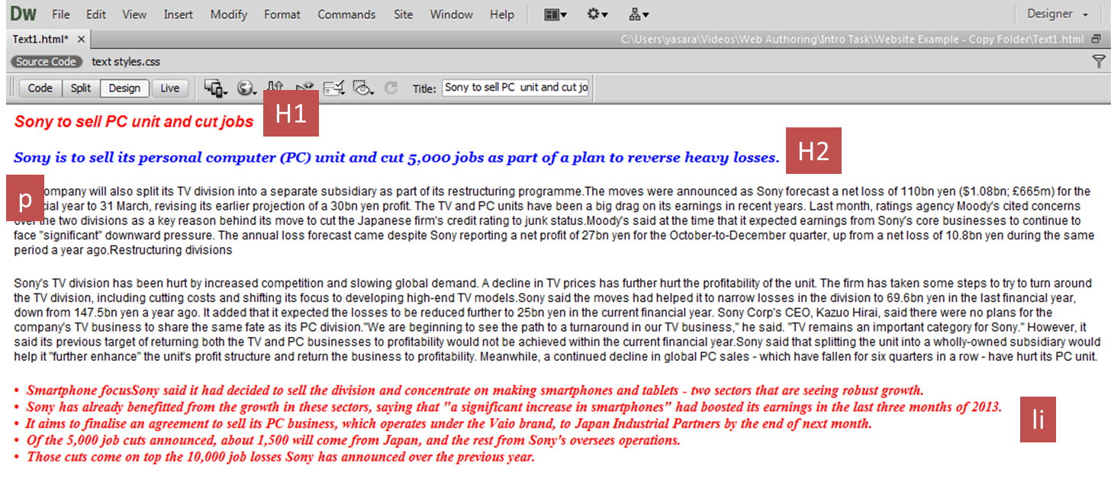
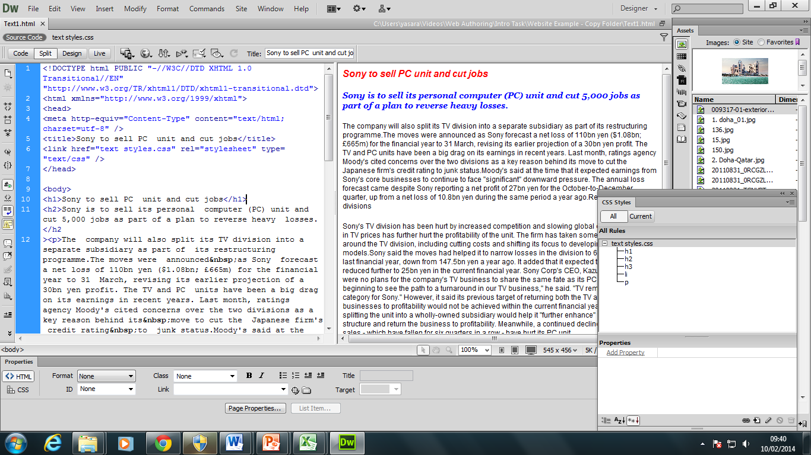
Web Authoring
Task 1 – Create Style Sheet
Open the text.html file Attach the CSV file you created Apply the text styles as shown in the image
Example: Remember to open <h1> and close </h1> the tags
Heading 1 tags

